Slide 1
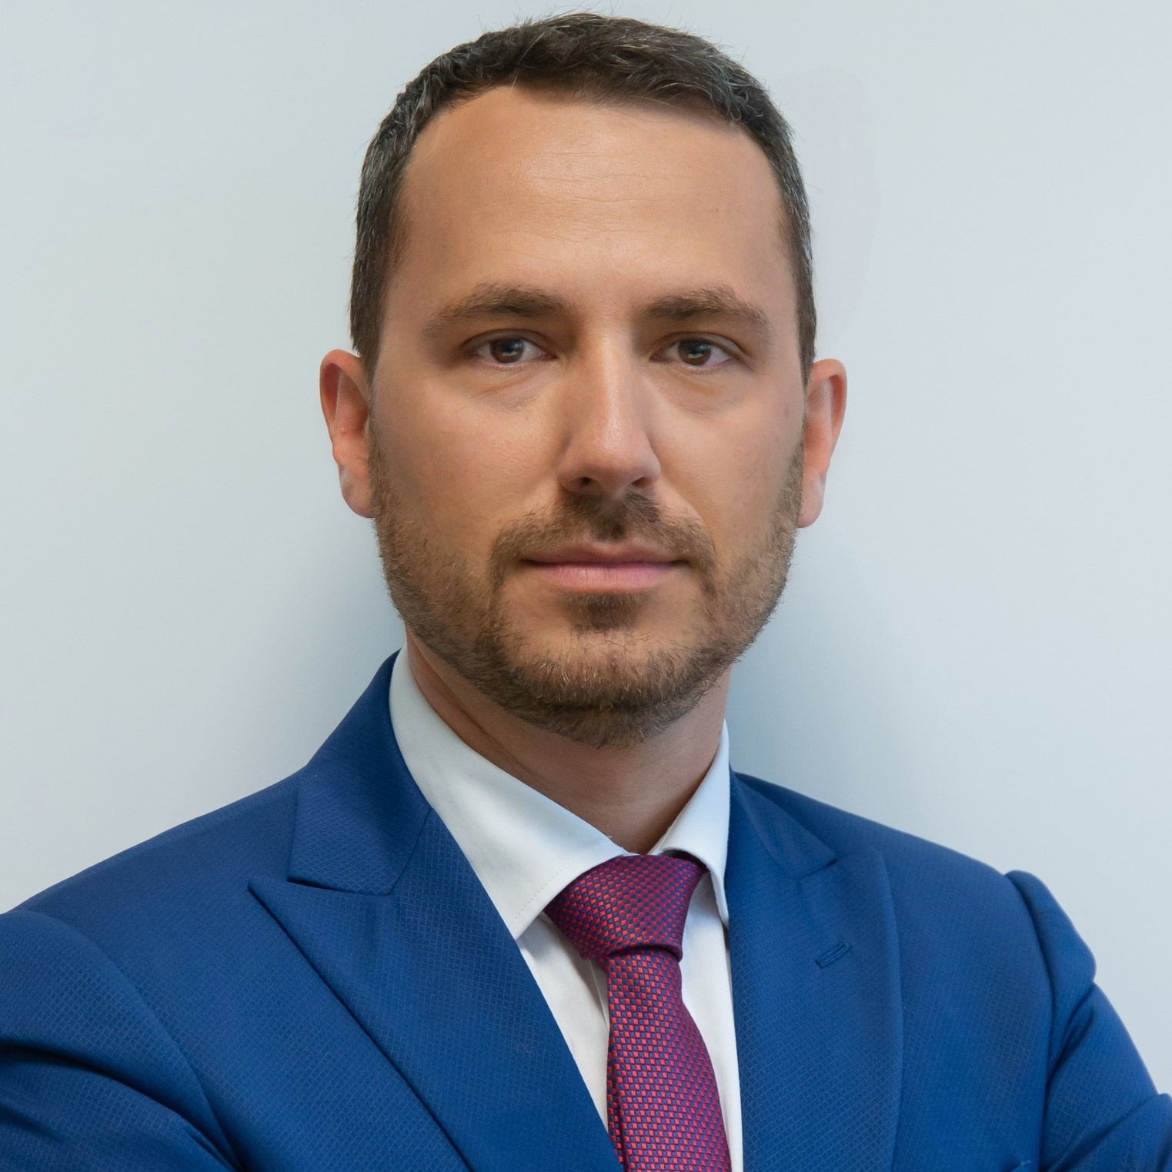






Nicola Sfondrini
Partner – Cloud Infrastructure and Architecture
M.S and Ph.D.
Computer science
Executive
MBA
Global
Management
Tech Council
Cloud Leader
Founder and VP

